Slide 1
MOTHER MAJERI PRIMARY SCHOOL
Computer Studies
LESSON NOTES
PRIMARY SIX
TERM 2 2019

Slide 2
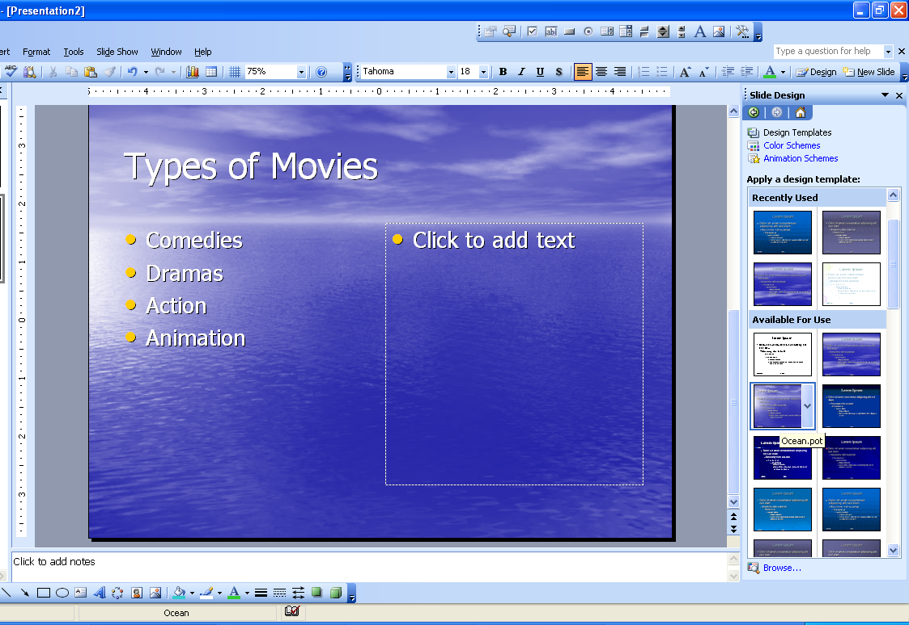
SECOND TERM, Lesson 1: Apply a Theme
A theme is set of colors, fonts, and special effects. Themes provide attractive backgrounds for your PowerPoint slides.
1. To apply a theme to all your slides in your presentations: Click on the Design button.
2. Click the design you want.

Slide 3
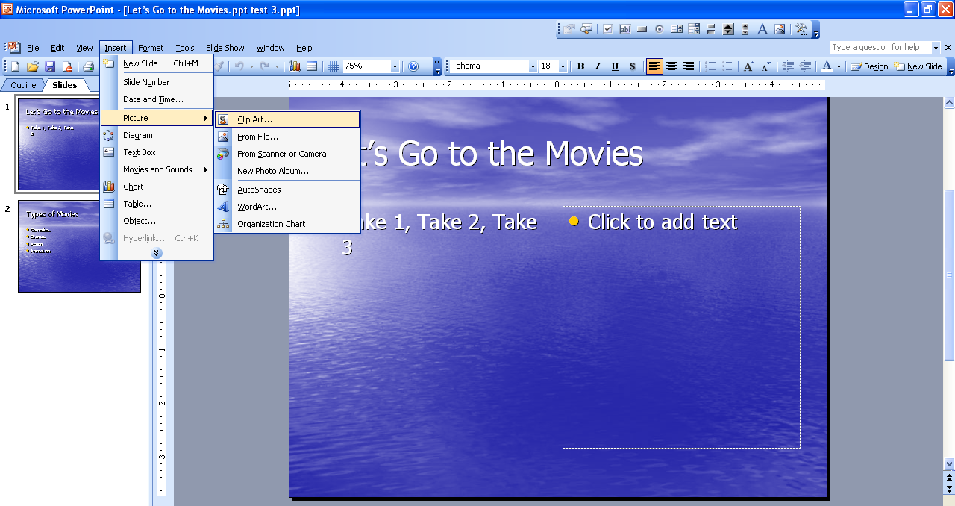
Lesson 2: Inserting Clipart onto your presentation
1. On the Menu toolbar Click Insert, a drop down box will appear.
2. Click on picture, another side box will appear click on Clipart..

Slide 4
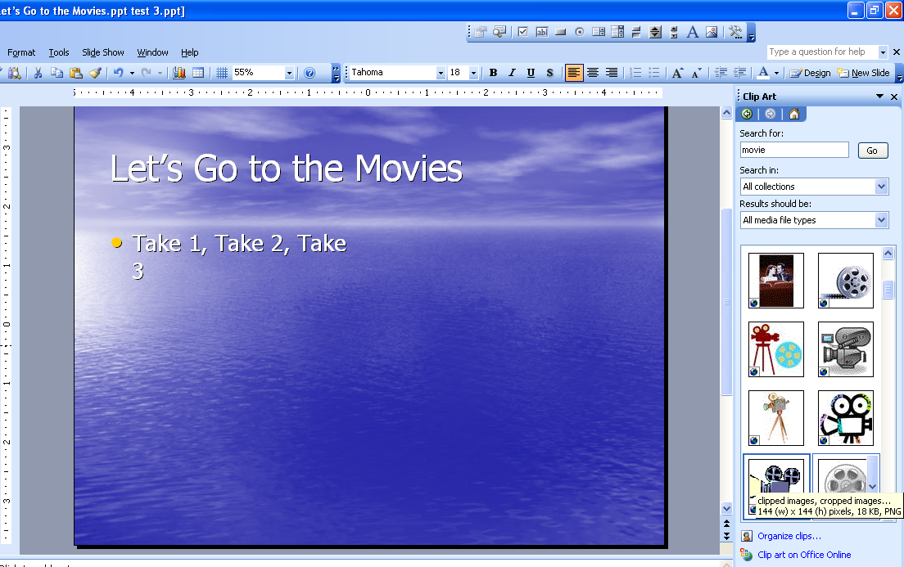
You will see that the "Insert Clip Art" task pane is visible on the right side of the slide .
3. Type Movie in the text box labeled Search for," and Click Go.
4. The Clipart task pane you will see clipart images that relate to the word you type in.
5. With your mouse, Double Click a movie camera. The camera will appear on your slide.

Slide 5
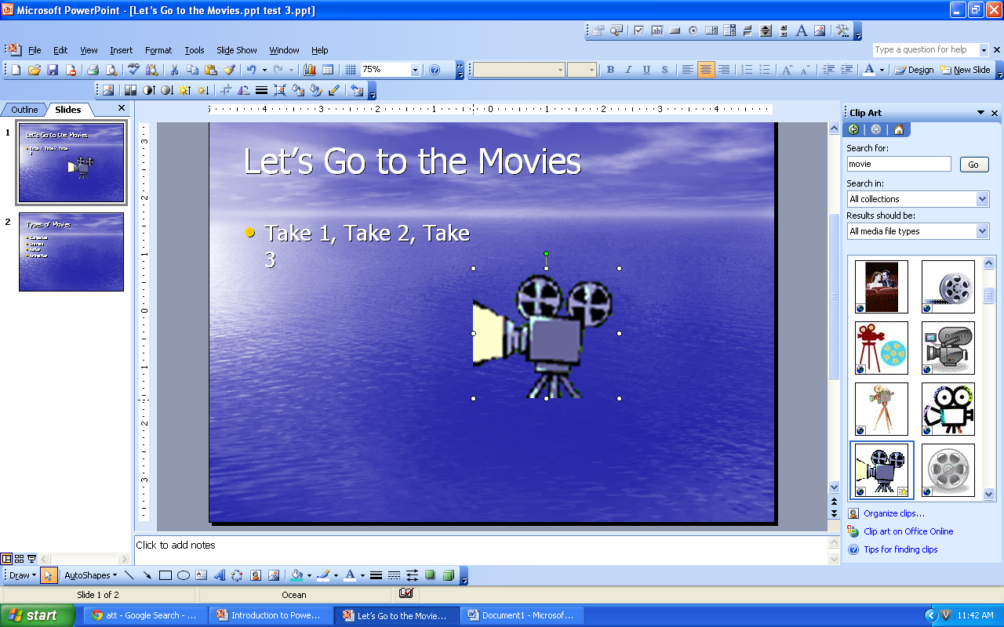
Lesson 3: Resize the shape of a picture:
1. Move your mouse over the picture and Click once to select it. You will see eight small circles appear along the edge of the picture. These circles are called "sizing handles." There is also one green circle, which is used to rotate the image.
2. Click on one of the sizing handles that appears on a side of the picture, hold the mouse button down, and drag the handle to change the shape of the picture. Your pointer will be a double-sided arrow when you are directly over a sizing handle.
3. Hold the mouse button down, and drag the picture to make it smaller or larger.

Slide 6
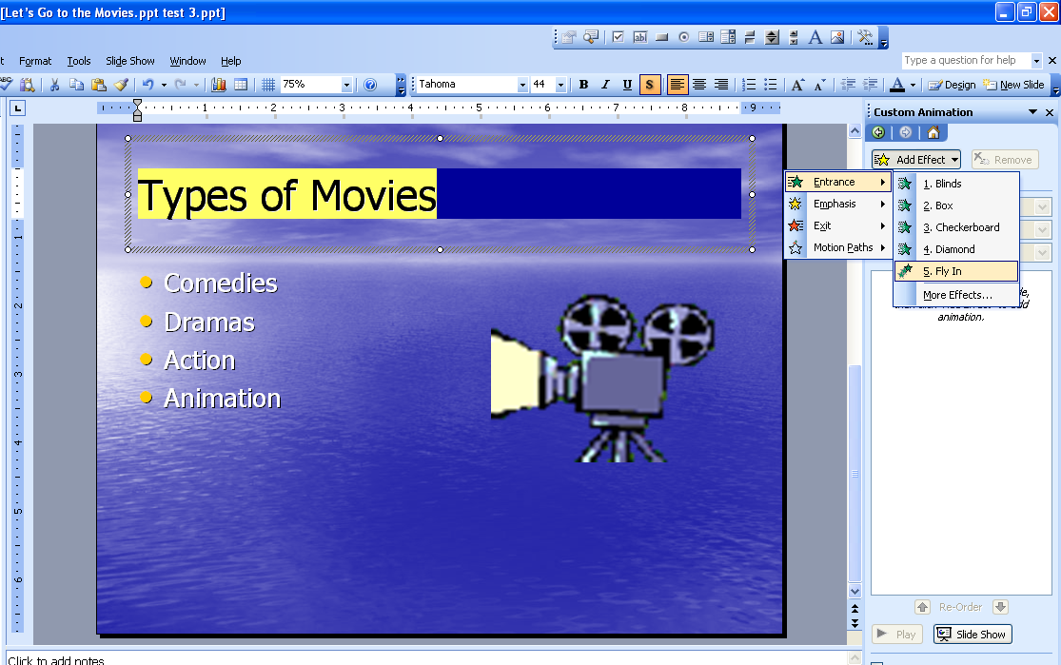
Lesson 4: Adding Animation
To animate text or clipart within your presentation;
1. Select the second slide in the slide plane, titles Types of Movies
2. Highlight the bulleted text
3. On the Menu toolbar click on Slideshow. A drop-down box will appear click Custom Animation
4. To the left of the slide, the Custom Animation task plane will appear. Click Add Effect.
5. When drop –down menu appears, Click Entrance and Click Fly In.

Slide 7
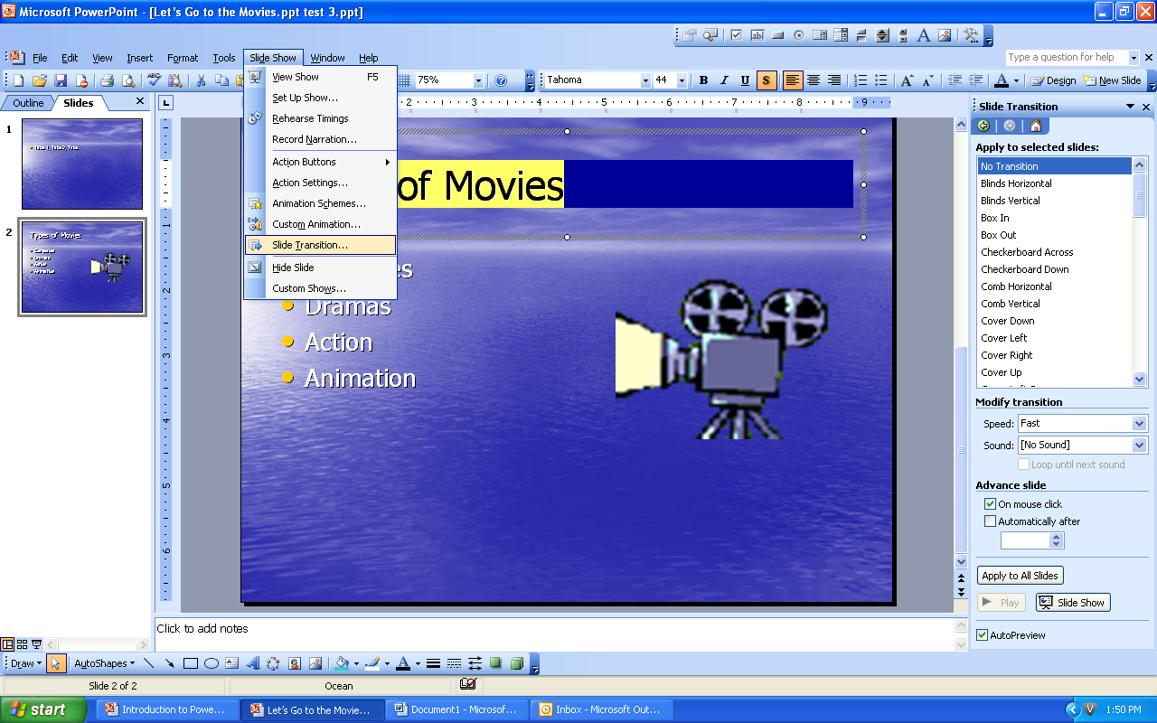
Lesson 5: Add Slide Transitions
1. On the Menu toolbar, Click the Slide Show tab.
A drop-down box will appear, Click Slide Transition.
2. To the left of the slide, the Slide Transition task pane will appear.
3. Click (a) Cover Down, (b) to set speed of transition click the drop-down box and click medium, (c) insert sound, click drop-down arrow and Click Arrow . Click Apply to All Slides
Save your Presentation

Slide 8
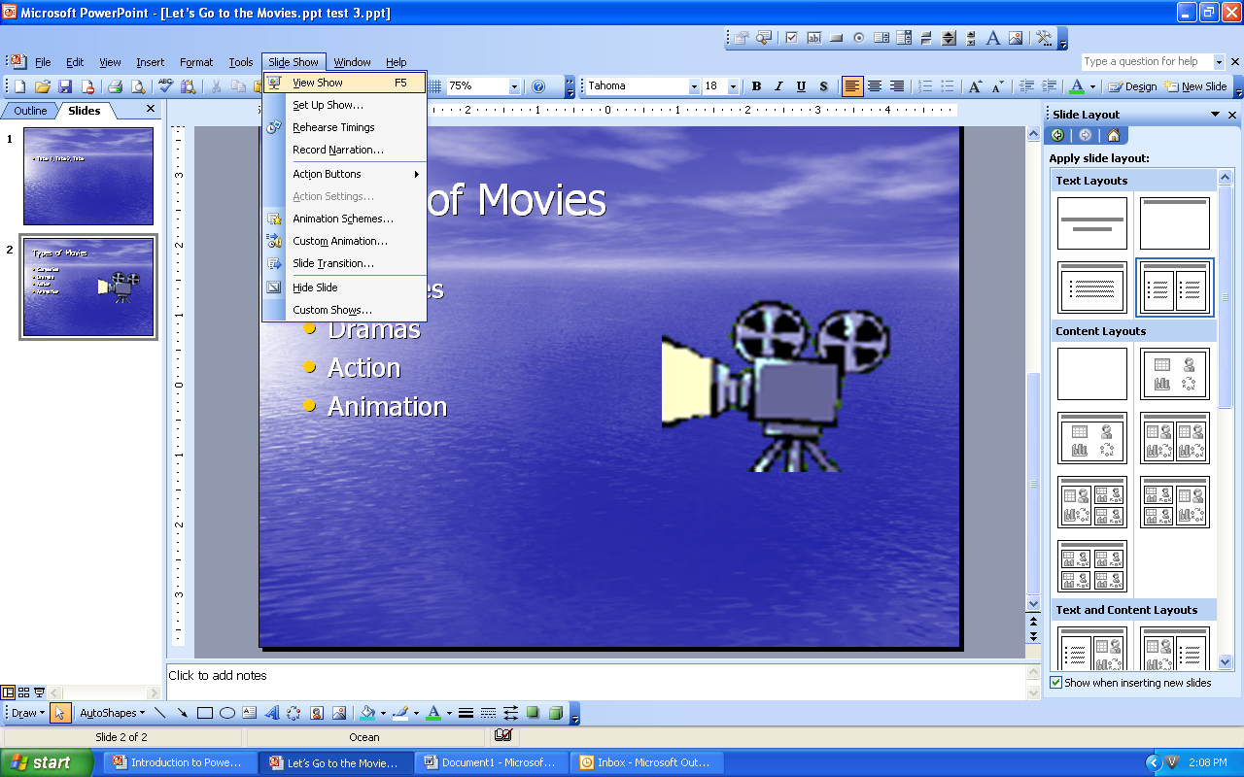
Lesson 6: Show presentation:
1. Click the first slide in the slides pane.
2. From the Menu toolbar Click Slideshow. A drop-down box will appear.
3. Click View Show
Click your mouse button, the slide show should advance to the next slide. Continue to click mouse until get black slide. Click mouse again to return to normal view of presentation. Save Work
Click Red X in top left corner to exit presentation

Slide 9
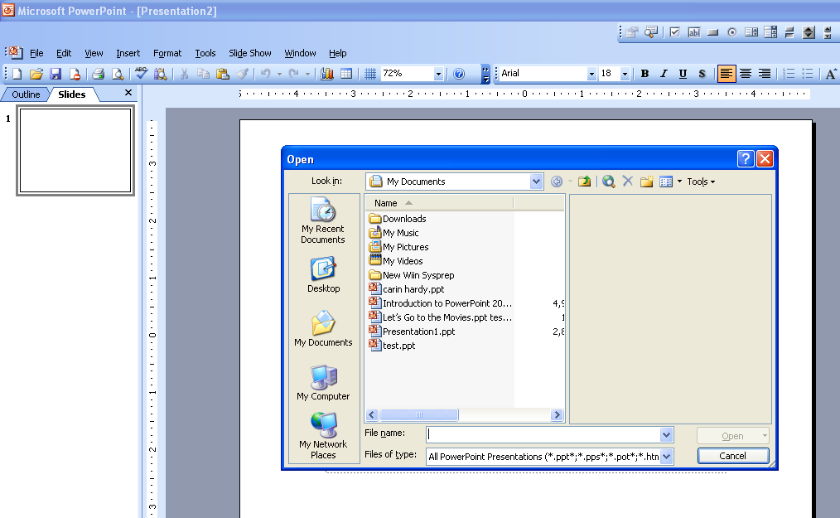
Lesson 7: Open a Saved PowerPoint presentation
1. Open PowerPoint.
2. From the Menu toolbar, Click File and Open. The Open File window should appear.
3. Click the desired file “ Let's Go the Movies” and click the Open button.

